Slide 1
Introduction to Signals and Systems
Dr. Arsla Khan

Slide 2
Course Contents
Text Book:
Signals and Systems
By A.V. Oppenheim and A. S. Willsky
Second Edition Prentice Hall, 2012
Introduction
Basic operations on signals
Basic system properties
Time domain analysis of continuous and discrete time systems
Fourier series analysis of CTS and DTS
Fourier transform analysis of CTS and DTS
Laplace Transform
Z Transform

Slide 3
Links for Video Lectures
Introduction to Signals and Systems:
https://www.youtube.com/watch?v=s8rsR_TStaA&list=PLBlnK6fEyqRhG6s3jYIU48CqsT5cyiDTO&index=1
Continuous and Discrete Time Signals
https://www.youtube.com/watch?v=H4hk6N5vC1Q&list=PLBlnK6fEyqRhG6s3jYIU48CqsT5cyiDTO&index=2
Time Shifting
https://www.youtube.com/watch?v=9Cd5nVCFfc0
https://www.youtube.com/watch?v=3Qzpj6UUxhE&list=PLBlnK6fEyqRhG6s3jYIU48CqsT5cyiDTO&index=273

Slide 4
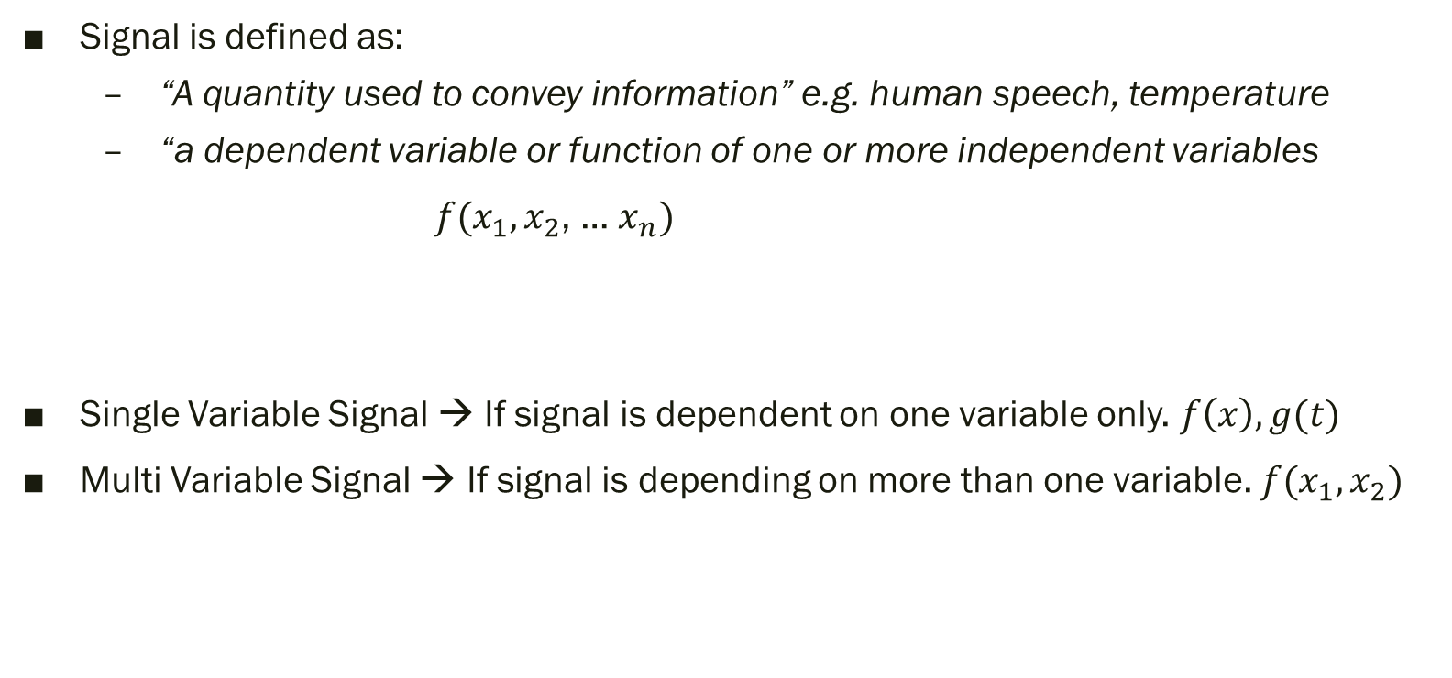
Signal
Signal is defined as:
“A quantity used to convey information” e.g. human speech, temperature
“a dependent variable or function of one or more independent variables
$f(x_{1},x_{2}$, … $x_{n})$
Single Variable Signal → If signal is dependent on one variable only. $f\left(x\right), g(t)$
Multi Variable Signal → If signal is depending on more than one variable. $f(x_{1},x_{2})$
signal
Independent Variables

Slide 5
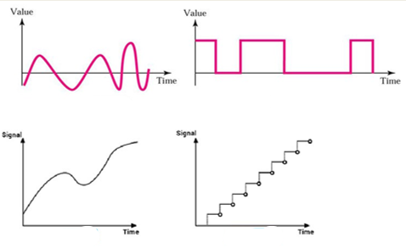
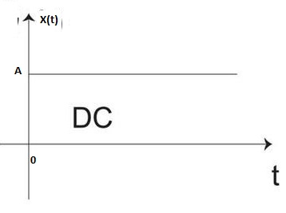
Difference btw signal and a dc value
anything which is varying is a signal but a constant value is not a signal
e.g. AC is a signal because current is changing with time. Whereas DC is not a signal because in DC, current is not changing with time.

Slide 6

System
It is defined as
The meaningful interconnection of physical devices and components is called as system
An entity that process a set of signals (input signal) and produces another set of signals.
System alone can not achieve anything so it must be linked with a signal.
desirable signal

Slide 7
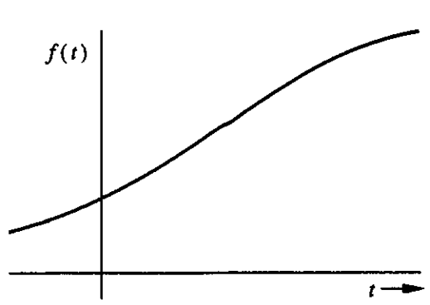
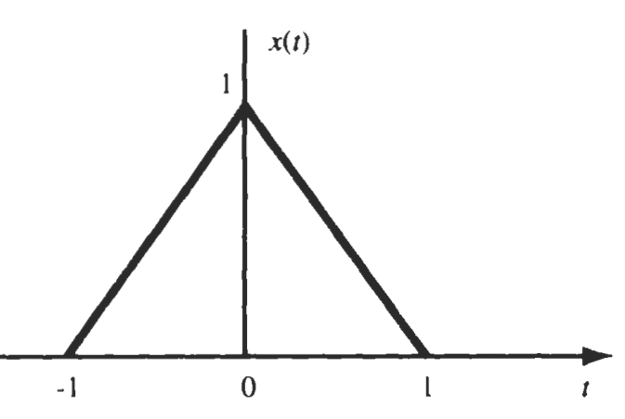

i) Continuous Time Signal (CTS)
Signals which are specified for every value of time (t)
It is written as $f\left(t\right), x\left(t\right), or g(t)$

Slide 8

ii) Discrete Time Signals (DTS)
Signals specified at discrete time intervals
It is written as $f\left[n\right], x\left[n\right], or g\left[n\right] / f\left(n\right), x\left(n\right), g(n)$

Slide 9
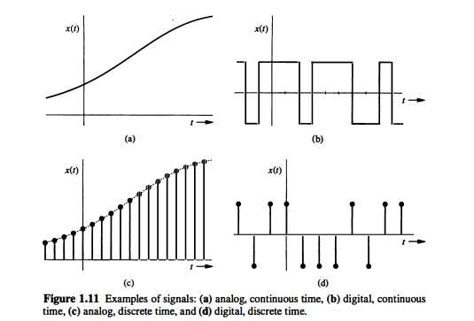

Slide 10
Thanks

